Slide 1
Project Presentation
Anna Leavitt

Slide 2
About Cholera
Cholera is an acute disease caused by infection of v. cholerae
Two different routes of transmission:
Waterborne: drinking infected water
Foodborne: ingesting contaminated food (most typically seafood)
Human behavior significant to occurrence and severity
Environmental hygiene
Personal hygiene
Food preparation
Often mild, can be severe
Fatality rate has declined over the decades due to positive changes in human hygiene and public awareness
Resources contribute greatly to CFR (case fatality ratio)
Dehydration

Slide 3
Cholera in Kenya - Rationale & Objective
Cholera in an endemic/epidemic
Made up of specific outbreaks in different areas on the world
Outbreaks most common in Africa and Southeast Asia
Kenya is a cholera endemic country
Big outbreaks this century: 2008, 2009, 2011, 2015
Sufficient data available
Epidemiological studies are imperative for improving human health outcomes
Objective
To analyze hotspots and clustering of cholera in Kenya dependant on case counts, death counts, and CFR (case fatality ratio) based on district
To analyze possible sources of outbreak - why are certain districts higher than others? Can we make guesses of outbreak sources based on geospatial variation?

Slide 4
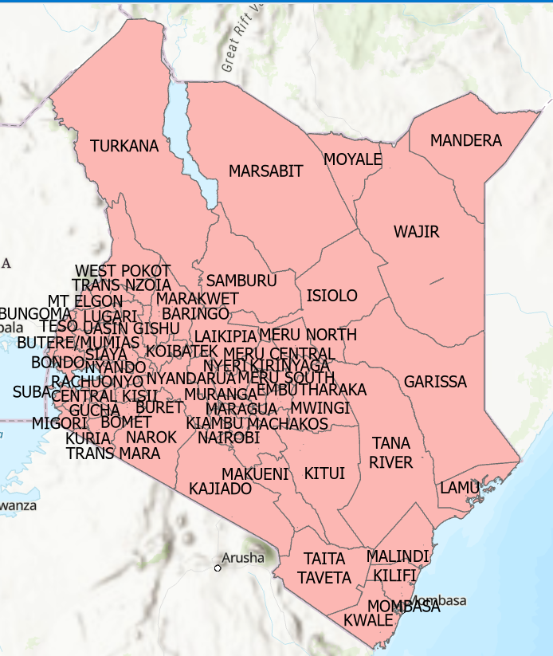
Data
Cholera case data provided by CDC
COVIS - Cholera surveillance system
Data available for 2009 outbreak
Comprehensive outbreak data sometimes not public
Generalized by district
Big report from the department of Health and Human Services
Case/death/CFR data pulled from report
Geospatial data of districts available from IGIS Map tool
Turkana areas digitized by myself based on local map

Slide 5
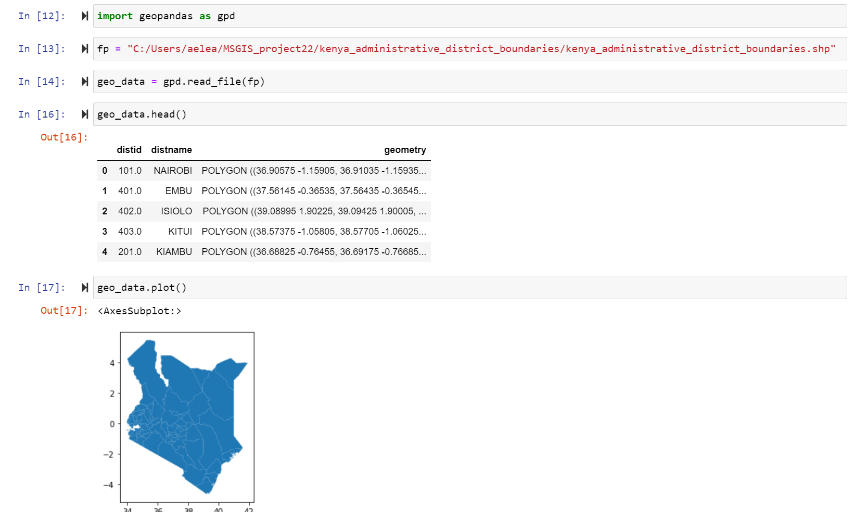
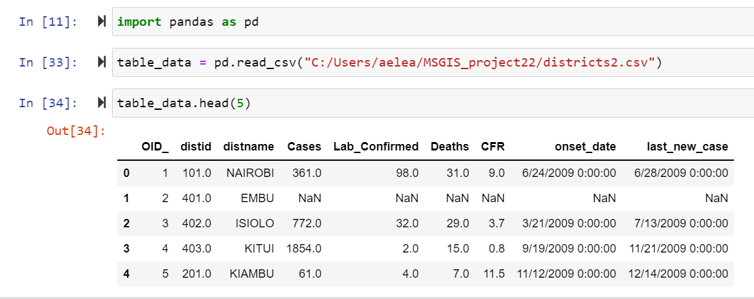
Workflow
Pandas & geopandas
Importing both spatial & non-spatial data
Merging
Visualizing results with matplotlib
Analyzing results based on cases, deaths, and case fatality ratio
Exploring hotspots

Slide 6
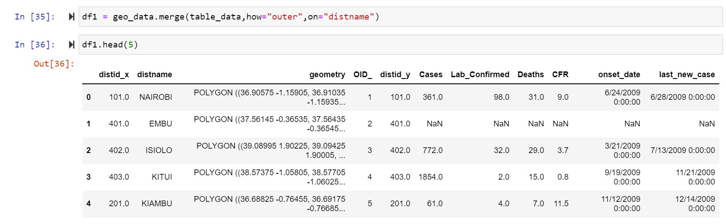
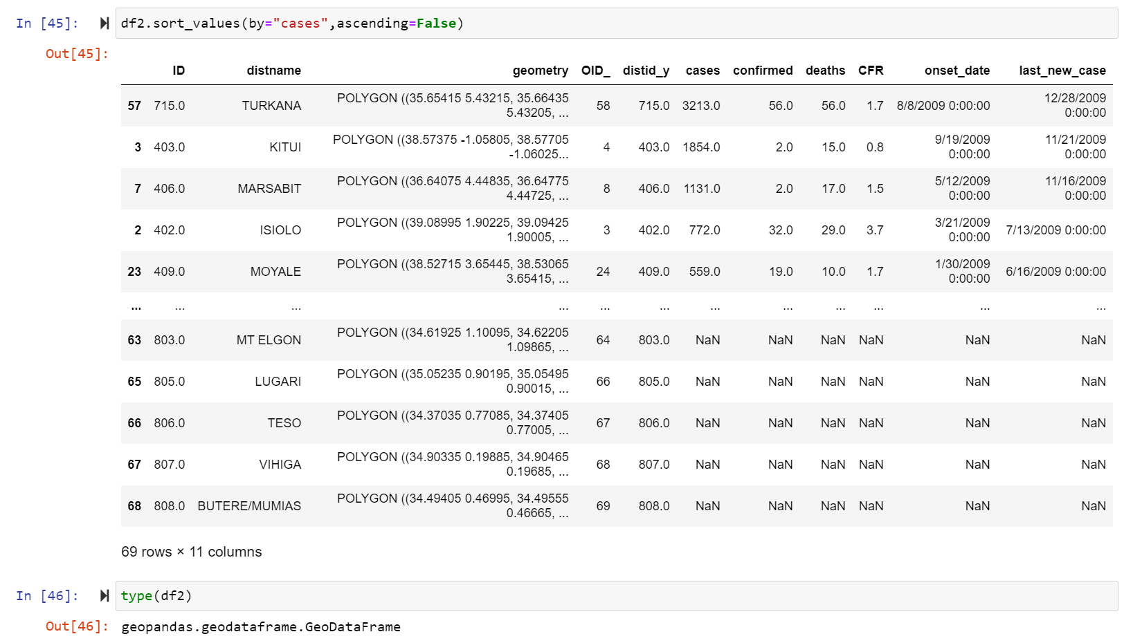
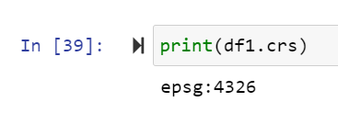
Workflow
Merging
Defining CRS
Sorting by cases:
Turkana (3213)
Kitui (1854)
Marsabit (1131)
Sorting by deaths:
Turkana (56)
Nairobi (31)
Isiolo (29)

Slide 7
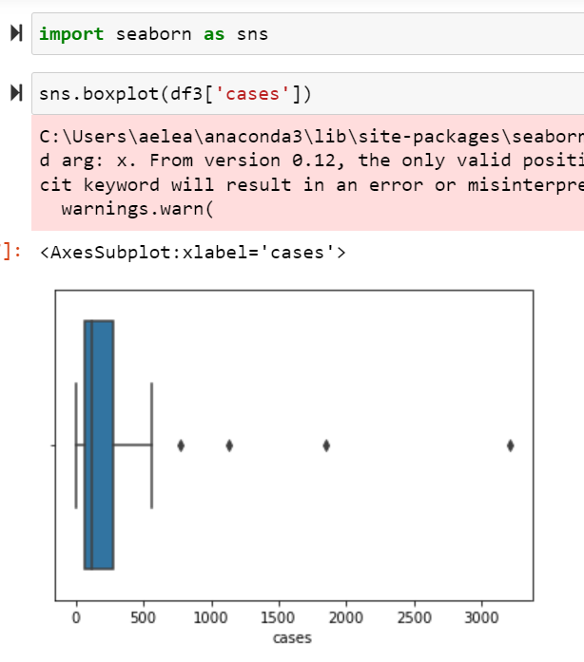
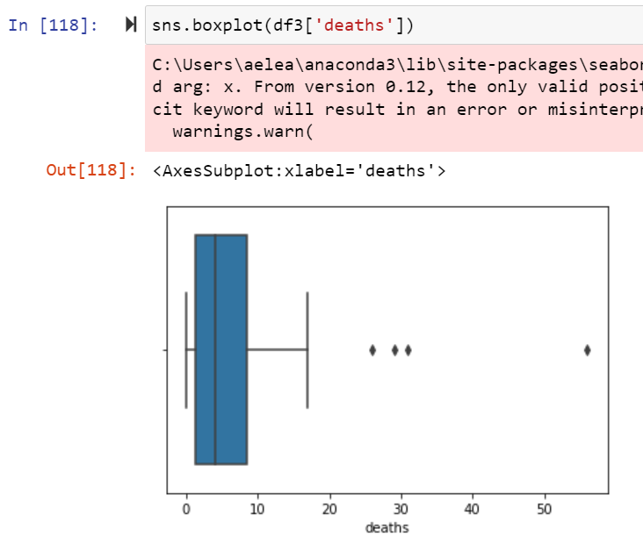
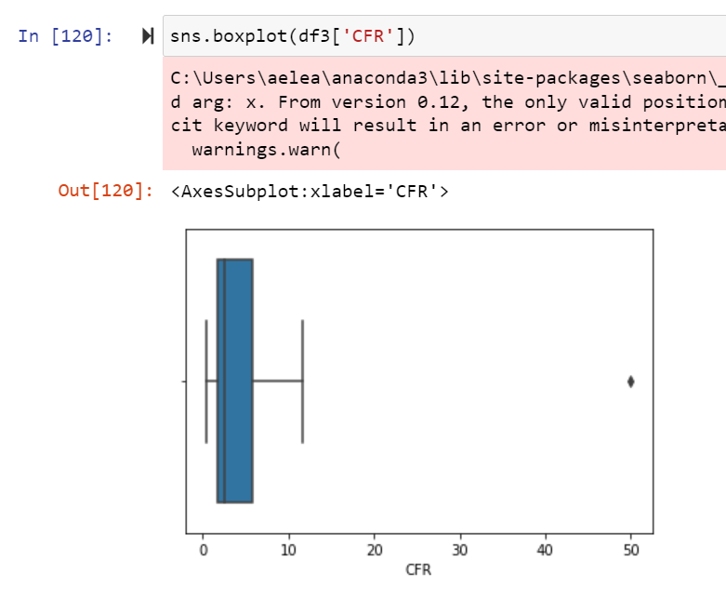
Boxplots

Slide 8
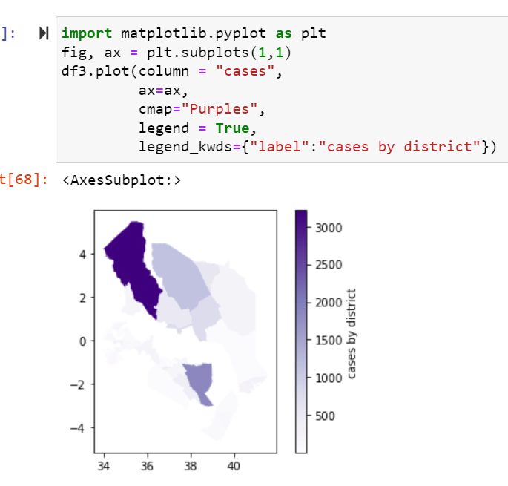
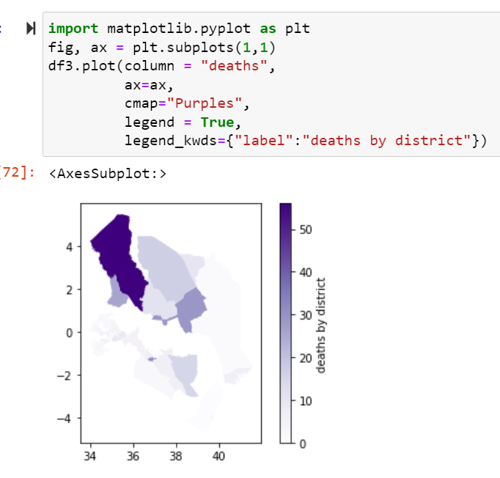
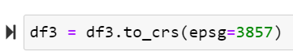
Plots

Slide 9
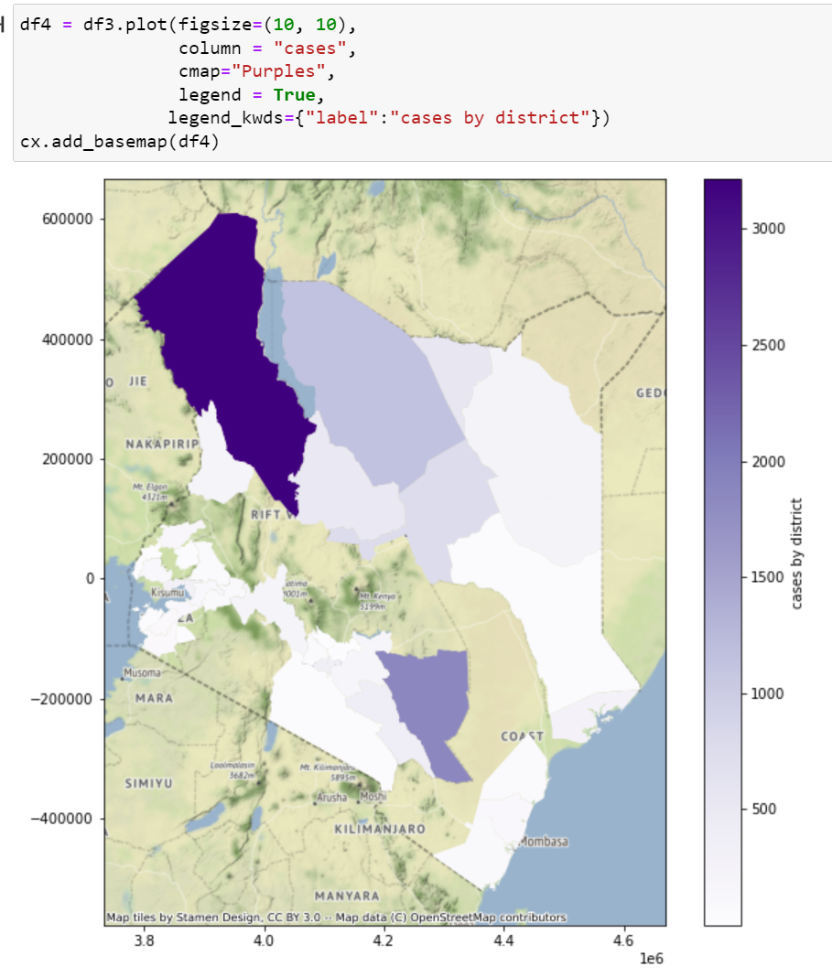
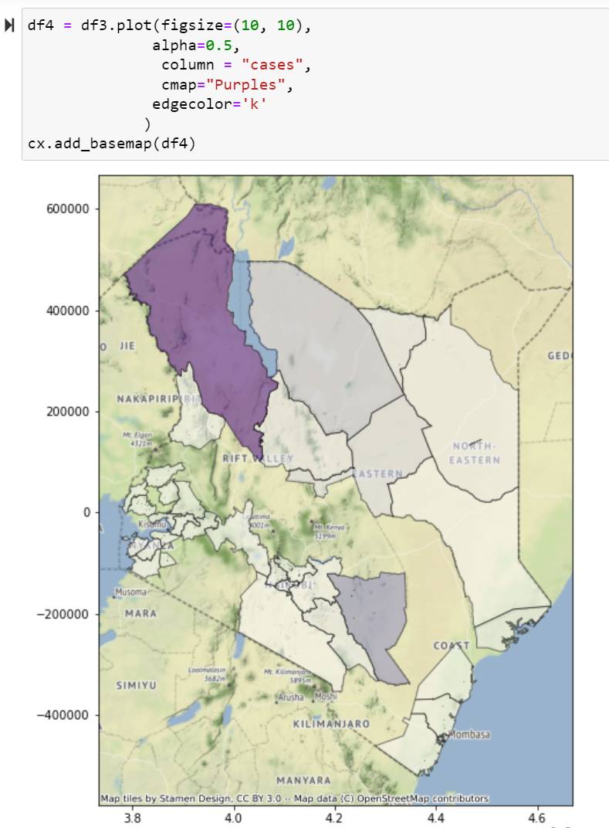
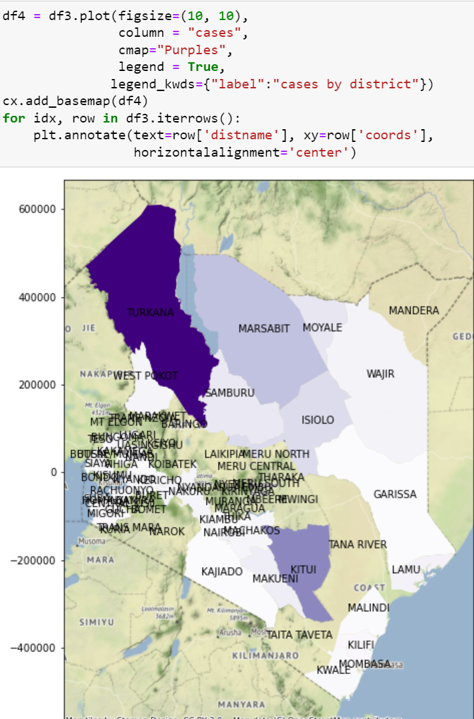
Cases

Slide 10
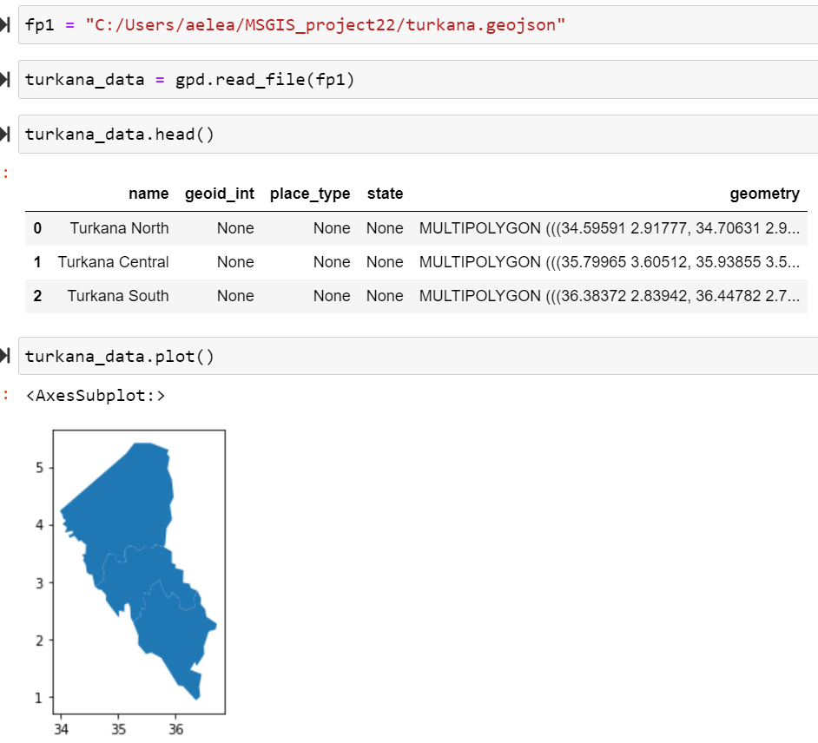
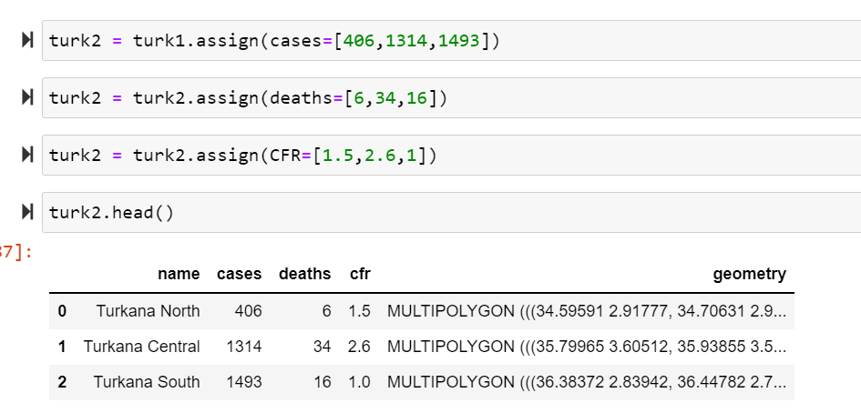
Turkana
I decided to take a closer look at Turkana, where the most cases seem clustered.
Original dataset specified three areas of Turkana: North, Central, and South (case #s)
I digitized Turkana boundaries & read in the geojson file to notebook
Modified the geodataframe to include cases, deaths, and case fatality ratio for each sub-section

Slide 11
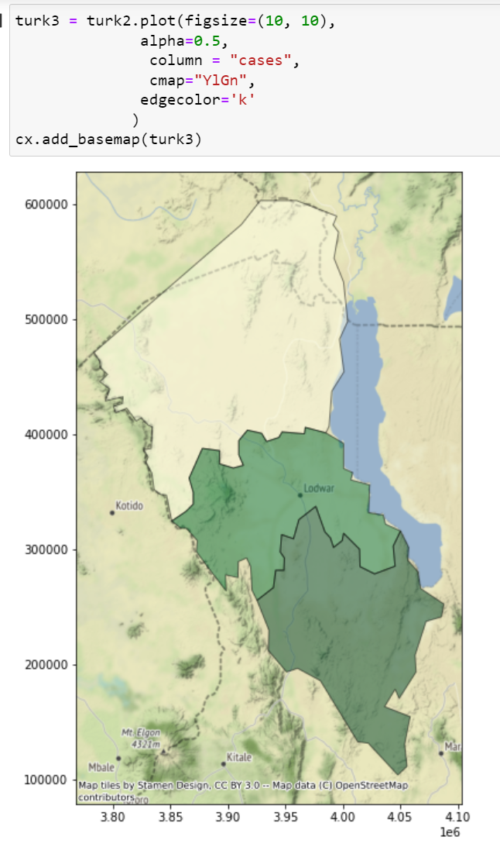
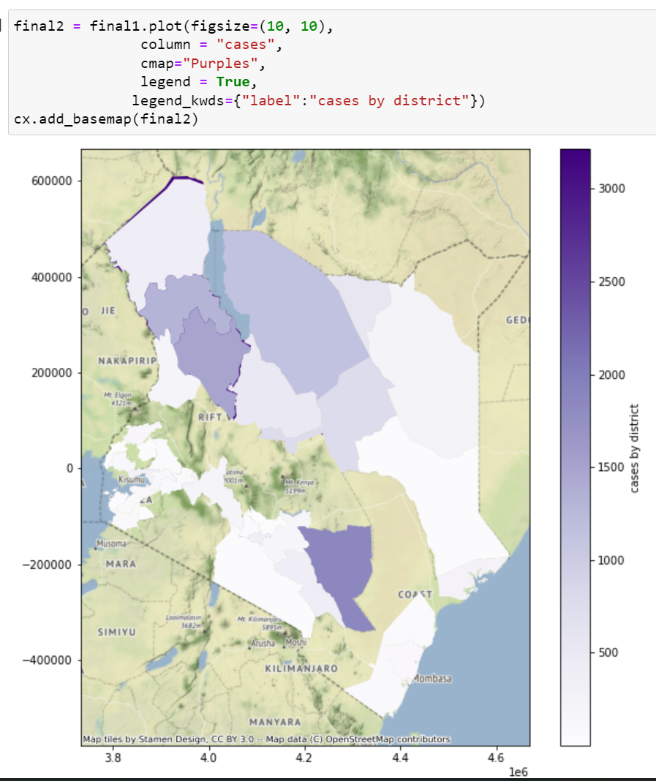
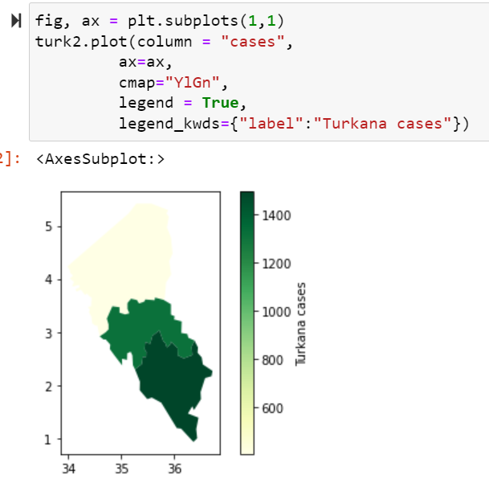
Appended Turkana geodataframe

Slide 12
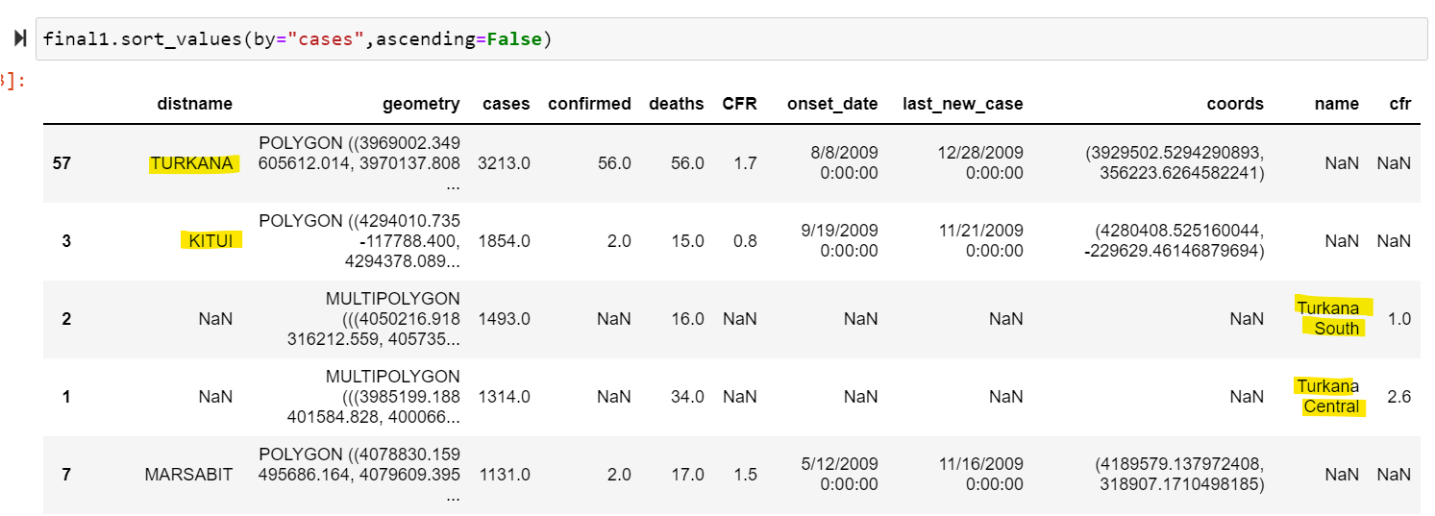
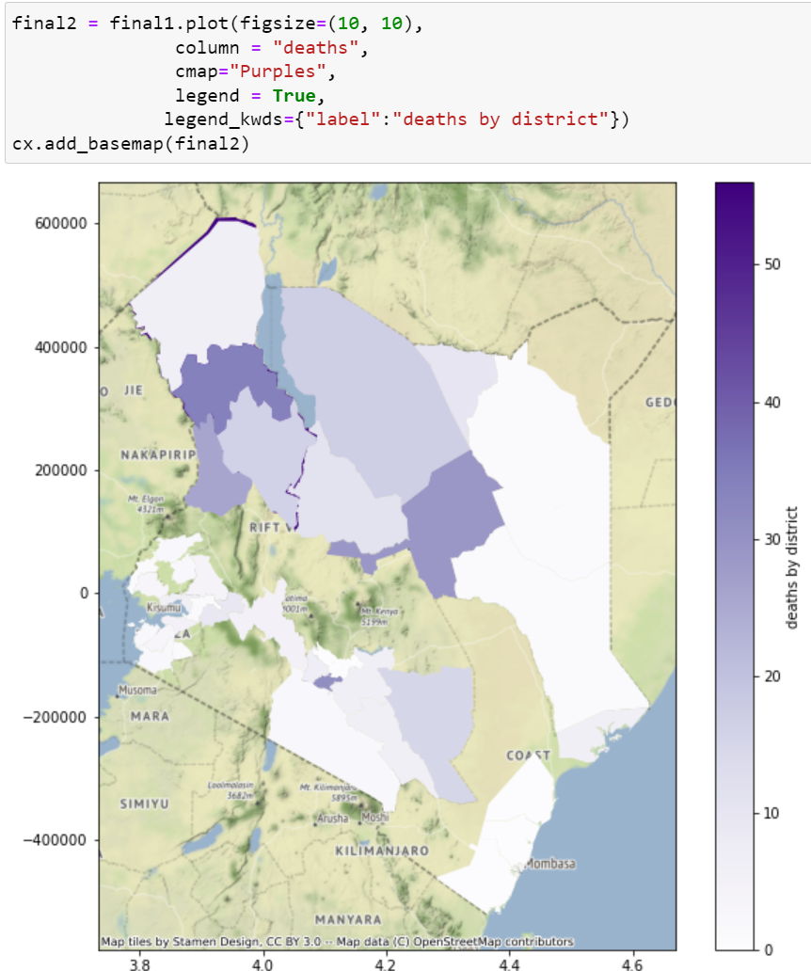
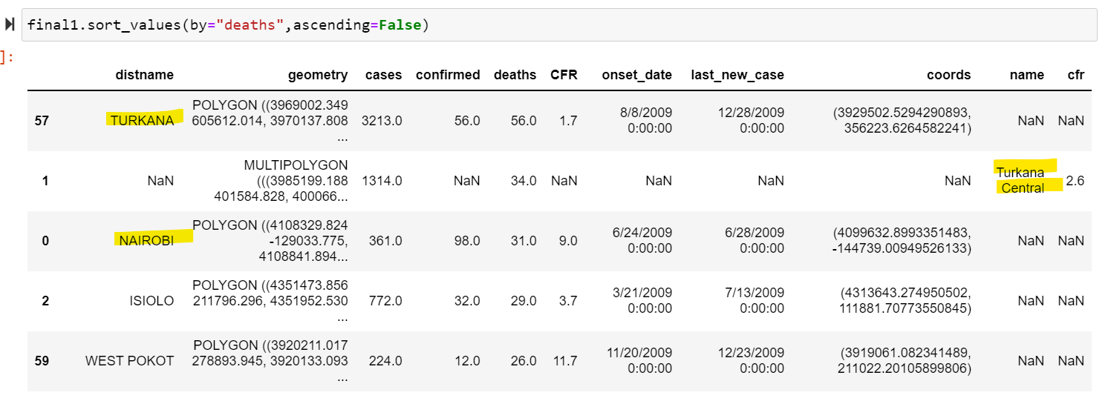
Final results: incl. ‘deaths’

Slide 13
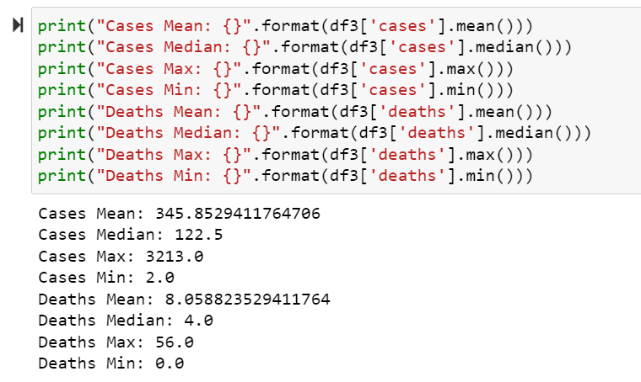
Results
Turkana has both the largest amount of cholera cases and deaths
Turkana South has most number of cases
Turkana Central has greatest number of deaths
Turkana North has significantly smaller values than the other two regions
Once Turkana was divided, Kitui had greatest number of cases - but Turkana South had second highest concentration
Kitui has very low CFR, Nairobi has very high CFR

Slide 14
Results cont.
No case / death data for a stretch of districts in more central Kenya
More cases around Turkana Lake than Lake Victoria / Indian Ocean
Significant results - cholera is waterborne disease
Most cases on west coast
Kitui results more likely foodborne related
The districts of Nairobi and West Pokot have a significantly higher case fatality ratio

Slide 15
Discussion - What does this mean?
For a public health professional:
Turkana Lake most likely has a high concentration of v. cholerae
Concentration focused on lower Turkana, west coast
The district of Kitui has an interestingly high amount of cholera cases for being an inland district
Investigate foodborne routes
Hygiene patterns?
Why are deaths higher in certain areas (Nairobi, W. Pokot, C. Turkana)?
Most likely lack of resources
I would be interested in comparing health outcomes in Nairobi vs. Kitui
Overall, hotpot analysis focuses on a cholera concentration in Turkana Lake. This is the most useful finding, but other interesting outcomes could be further investigated

Slide 16
Questions?

